Slide 1
SE 6387 – Advanced Software Engineering Project
Parking Spot Locator
Arunkumar Manickam
Hariprasad Natarajan
Prasanna Venkatesh Venkitasamy
Rekha Muthulakshmi Nachadalingam

Slide 2
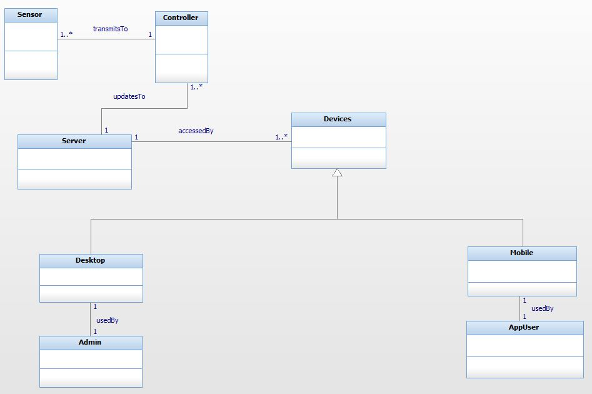
Domain Model

Slide 3
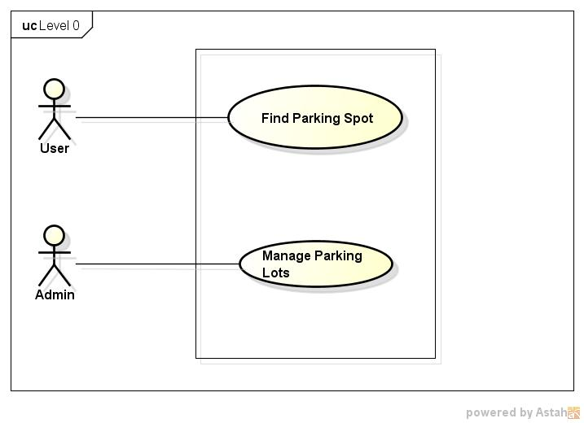
Use Case Diagram – Level 0

Slide 4
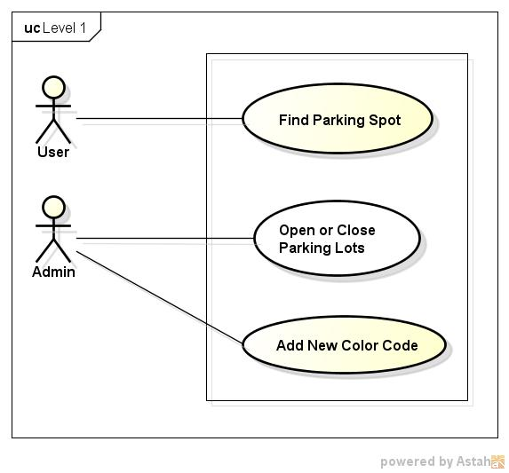
Use Case Diagram – Level 1

Slide 5
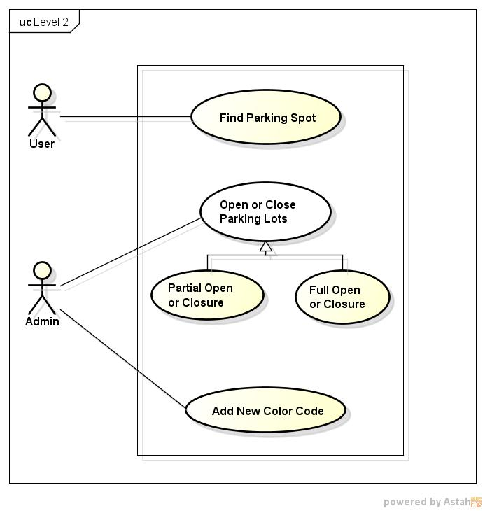
Use Case Diagram – Level 2

Slide 6
Reqt. Traceability matrix
Use Cases
 |  | UC0.1 | UC0.2 | UC1.1 | UC1.2 | UC1.3 | UC2.1 | UC2.2 | UC2.3 | UC2.4 | UC2.5
 | FR1.1
 | FR1.2
 | FR1.3
 | FR2.1
 | FR2.2
 | FR2.3
 | FR2.4
 | FR3.1
 | FR3.2
 | FR4.1
 | FR5.1
Functional Requirements

Slide 7
THANK YOU !

